Slide 1
Applied Cryptography ElGamal cryptosystem, Shanks’ algorithm, Pollard Rho algorithm
Liangfeng Zhang
School of Information Science and Technology
ShanghaiTech University

Slide 2
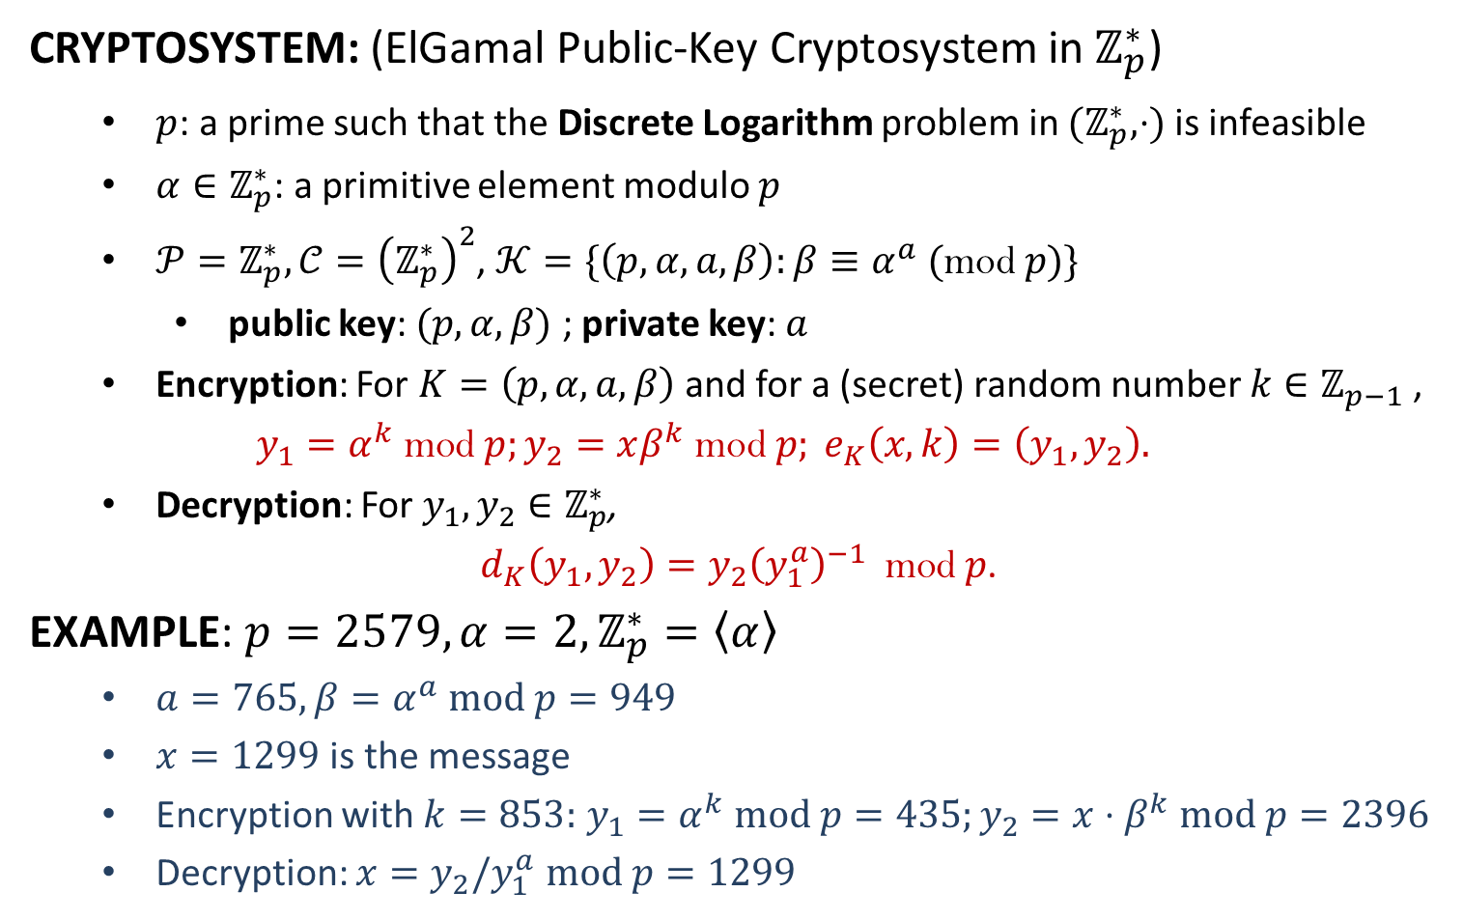
ElGamal Cryptosystem
CRYPTOSYSTEM: (ElGamal Public-Key Cryptosystem in $ℤ_{p}^{∗}$)
$p$: a prime such that the Discrete Logarithm problem in ${(ℤ}_{p}^{∗},⋅)$ is infeasible
$α∈ℤ_{p}^{∗}$: a primitive element modulo $p$
$𝒫=ℤ_{p}^{∗}, 𝒞={\left(ℤ_{p}^{∗}\right)}^{2}$, $𝒦=\{\left(p,α,a,β\right):β≡α^{a}\text{ (}\text{mod} p)\}$
public key: $(p,α,β)$ ; private key: $a$
Encryption: For $K=\left(p,α,a,β\right)$ and for a (secret) random number $k{∈ℤ}_{p−1}$,
$$y_{1}=α^{k} \text{mod} p;y_{2}=xβ^{k} \text{mod} p; e_{K}\left(x,k\right)=\left(y_{1},y_{2}\right).$$
Decryption: For $y_{1},y_{2}∈ℤ_{p}^{∗}$,
$d_{K}\left(y_{1},y_{2}\right)=y_{2}{\left(y_{1}^{a}\right)}^{−1} \text{mod} p$.
EXAMPLE: $p=2579, α=2, ℤ_{p}^{∗}=〈α〉$
$a=765, β=α^{a} mod p=949$
$x=1299$ is the message
Encryption with $k=853:$ $y_{1}=α^{k} mod p=435;y_{2}=x⋅β^{k} mod p=2396$
Decryption: $x=y_{2}/y_{1}^{a}$ $mod p=1299$

Slide 3
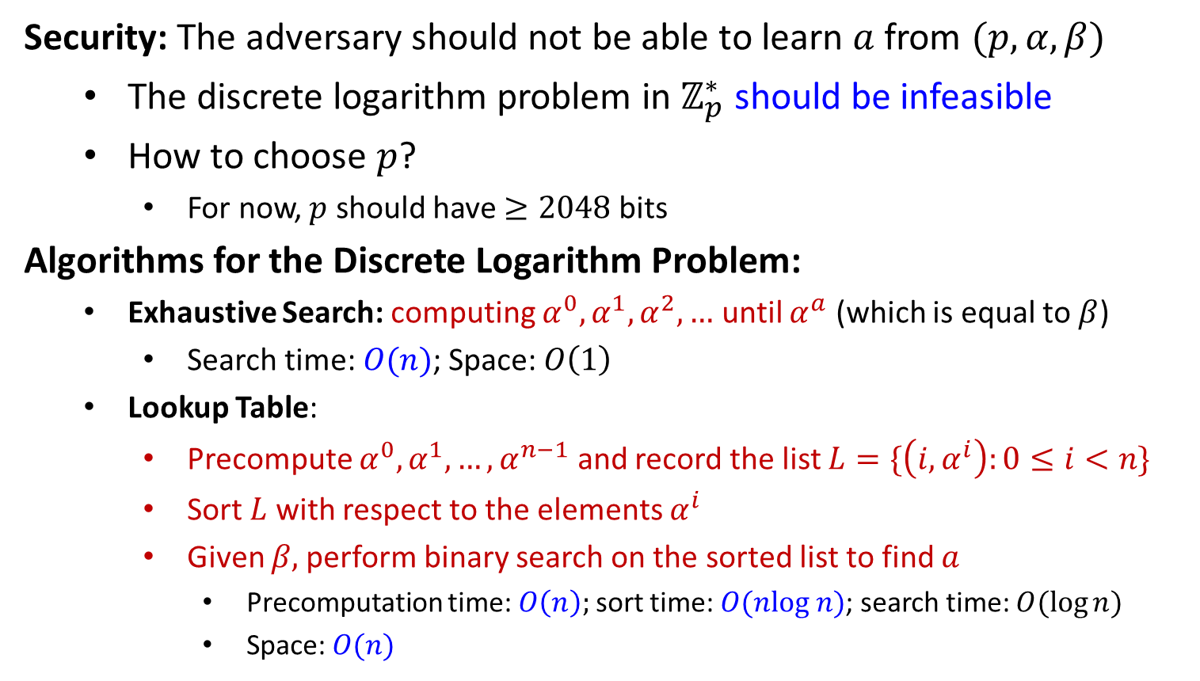
ElGamal Cryptosystem
Security: The adversary should not be able to learn $a$ from $(p,α,β)$
The discrete logarithm problem in $ℤ_{p}^{∗}$ should be infeasible
How to choose $p$?
For now, $p$ should have $≥2048$bits
Algorithms for the Discrete Logarithm Problem:
Exhaustive Search: computing $α^{0},α^{1},α^{2},…$ until $α^{a}$ (which is equal to $β$)
Search time: $O(n)$; Space: $O\left(1\right)$
Lookup Table:
Precompute $α^{0}, α^{1}, …,α^{n−1}$ and record the list $L=\{\left(i,α^{i}\right):0≤i<n\}$
Sort $L$ with respect to the elements $α^{i}$
Given $β,$perform binary search on the sorted list to find $a$
Precomputation time: $O\left(n\right);$sort time: $O(nlog n)$; search time: $O(\log{n})$
Space: $O(n)$

Slide 5




























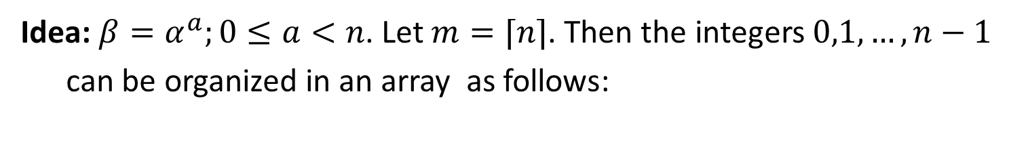







Shanks’ Algorithm (BSGS, 1969)
Idea: $β=α^{a};0≤a<n$. Let $m=⌈n⌉$. Then the integers $0,1,…,n−1$
can be organized in an array as follows:
0
1
$$⋯$$
$$⋯$$
$$⋯$$
$$m−1$$
$$m$$
$$m+1$$
$$⋯$$
$$⋯$$
$$⋯$$
$$2m−1$$
$$⋮$$
$$⋮$$
$$⋯$$
$$⋯$$
$$⋯$$
$$⋮$$
$$j_{0}$$
$$⋮$$
$$⋮$$
$$⋯$$
$$a$$
$$⋯$$
$$⋮$$
$$⋮$$
$$⋮$$
$$⋯$$
$$⋯$$
$$⋯$$
$$⋮$$
$$m^{2}−m$$
$$m^{2}−m+1$$
$$⋯$$
$$⋯$$
$$⋯$$
$$m^{2}−1$$
$$i_{0}$$
$$a=j_{0}m+i_{0}$$
How to find $j_{0}$ and $i_{0}$?
Construct two lists

Slide 6




















Shanks’ Algorithm
Idea: $β=α^{a};0≤a<n$. Let $m=⌈n⌉$. Then the integers $0,1,…,n−1$
can be organized in an array as follows:
$$α^{0}$$
0
$$α^{j_{0}m}=βα^{−i_{0}}$$
$$α^{m}$$
$$m$$
$$⋮$$
$$⋮$$
$$α^{j_{0}m}$$
$$j_{0}m$$
$$⋮$$
$$⋯$$
$$a$$
$$⋯$$
$$⋮$$
$$⋮$$
$$⋮$$
$$α^{m^{2}−m}$$
$$m^{2}−m$$
List 1
$$βα^{0}$$
$$βα^{−1}$$
$$⋯$$
$$βα^{−i_{0}}$$
$$⋯$$
$$βα^{−(m−1)}$$
List 2
$$0$$
$$1$$
$$⋯$$
$$i_{0}$$
$$⋯$$
$$m−1$$

Slide 7
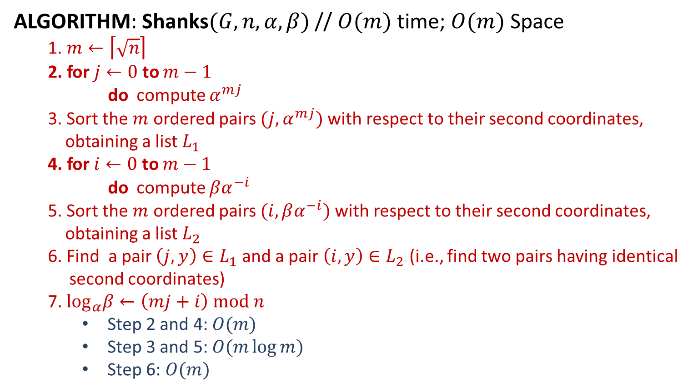
Shanks’ Algorithm
ALGORITHM$:$ Shanks$(G,n,α,β)$ // $O(m)$ time; $O(m)$ Space
1. $m←\left\lceil \sqrt{n}\right\rceil$
2. for $j←0$ to $m−1$
do compute $α^{mj}$
3. Sort the $m$ ordered pairs $(j,α^{mj})$ with respect to their second coordinates,
obtaining a list $L_{1}$
4. for $i←0$ to $m−1$
do compute $βα^{−i}$
5. Sort the $m$ ordered pairs $(i,βα^{−i})$ with respect to their second coordinates,
obtaining a list $L_{2}$
6. Find a pair $\left(j,y\right)∈L_{1}$ and a pair $\left(i,y\right)∈L_{2}$ (i.e., find two pairs having identical
second coordinates)
7. $\log_{α}β←\left(mj+i\right) mod n$
Step 2 and 4: $O(m)$
Step 3 and 5: $O(m\log{m})$
Step 6: $O(m)$

Slide 8
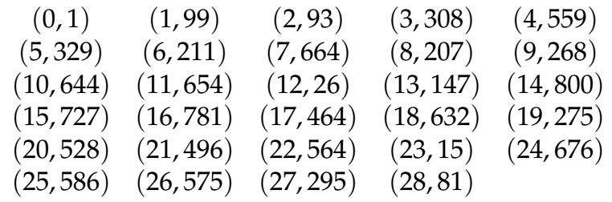
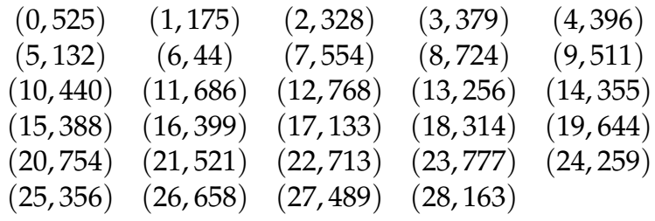

Shanks’ Algorithm
EXAMPLE$:$ $p=809;α=3, β=525;\log_{α}{β=?}$
$n=p−1=808 ;$
$m=\left\lceil \sqrt{n}\right\rceil =29$
$j_{0}=10;i_{0}=19;a=j_{0}m+i_{0}=10×29+19=309$
$3^{309}≡525 (mod 809)$
List 1
List 2

Slide 10
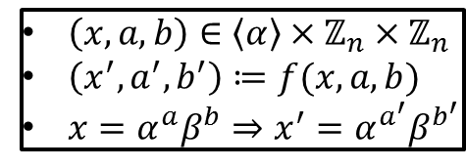
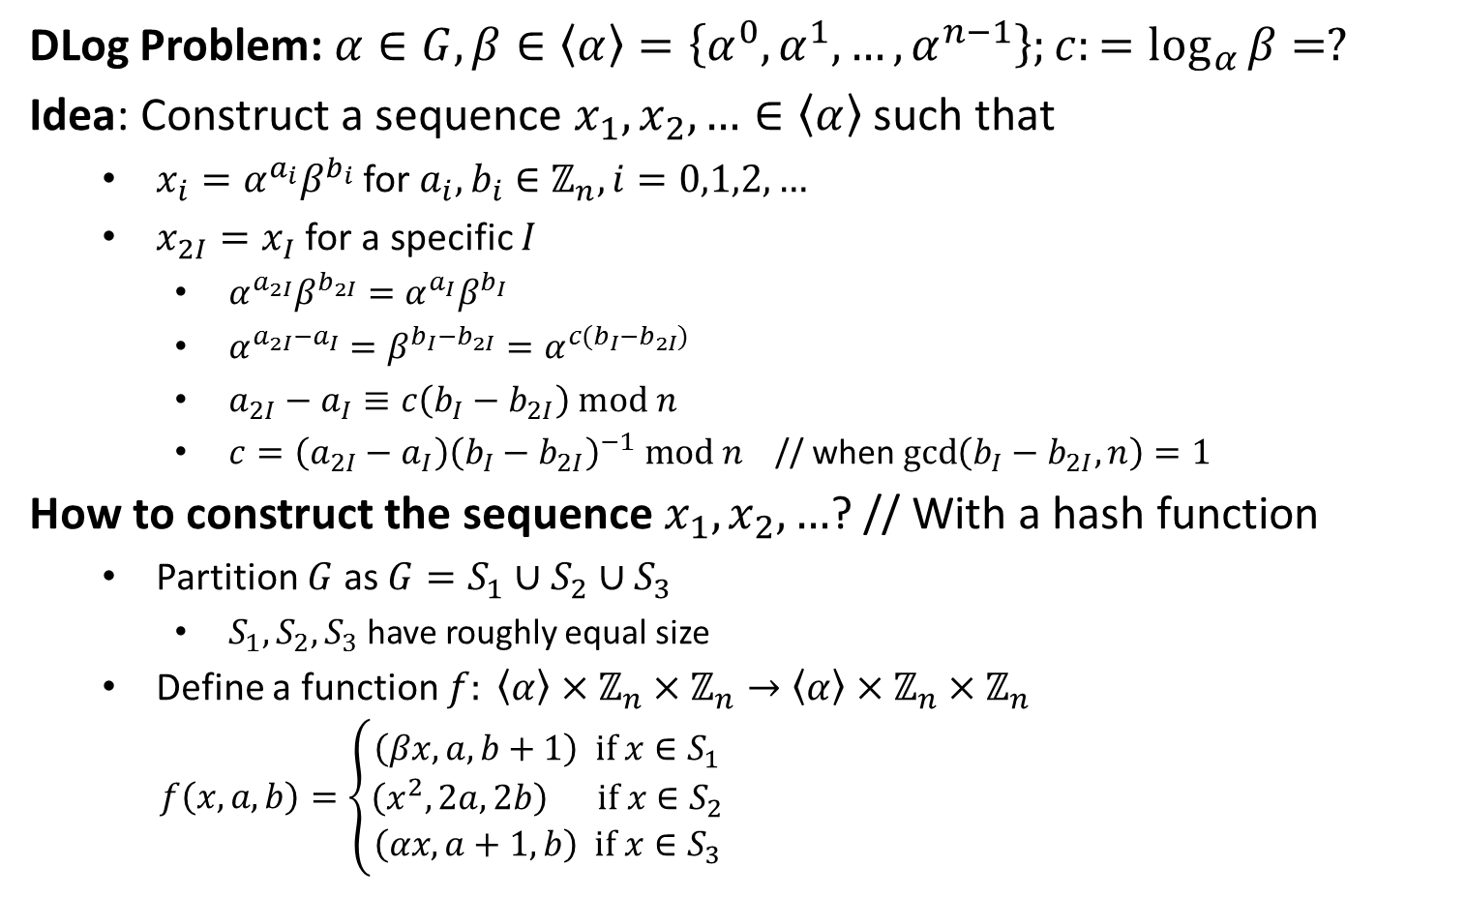
Pollard Rho Algorithm (1978)
DLog Problem: $α∈G, β∈〈α〉=\left\{α^{0},α^{1},…,α^{n−1}\right\};c:=\log_{α}{β}=?$
Idea: Construct a sequence $x_{1},x_{2},…∈〈α〉$ such that
$x_{i}=α^{a_{i}}β^{b_{i}}$ for $a_{i},b_{i}∈ℤ_{n}, i=0,1,2,…$
$x_{2I}=x_{I}$ for a specific $I$
$α^{a_{2I}}β^{b_{2I}}=α^{a_{I}}β^{b_{I}}$
$α^{a_{2I}−a_{I}}=β^{b_{I}−b_{2I}}=α^{c(b_{I}−b_{2I})}$
$a_{2I}−a_{I}≡c\left(b_{I}−b_{2I}\right) mod n$
$c=\left(a_{2I}−a_{I}\right){\left(b_{I}−b_{2I}\right)}^{−1} mod n$ // when $\gcd\left(b_{I}−b_{2I},n\right)=1$
How to construct the sequence $x_{1},x_{2},…$? // With a hash function
Partition $G$ as $G=S_{1}∪S_{2}∪S_{3}$
$S_{1},S_{2},S_{3}$ have roughly equal size
Define a function $f: 〈α〉×ℤ_{n}×ℤ_{n}→〈α〉×ℤ_{n}×ℤ_{n}$
$f\left(x,a,b\right)=\left\{\begin{aligned}\left(βx, a,b+1\right) if x∈S_{1} \\ \left(x^{2},2a,2b\right) if x∈S_{2} \\ \left(αx, a+1,b\right) if x∈S_{3}\end{aligned}\right.$
$\left(x,a,b\right)∈〈α〉×ℤ_{n}×ℤ_{n}$
$\left(x^{′},a^{′},b^{′}\right)≔f(x,a,b)$
$x=α^{a}β^{b}⇒x^{′}=α^{a^{′}}β^{b^{′}}$

Slide 11
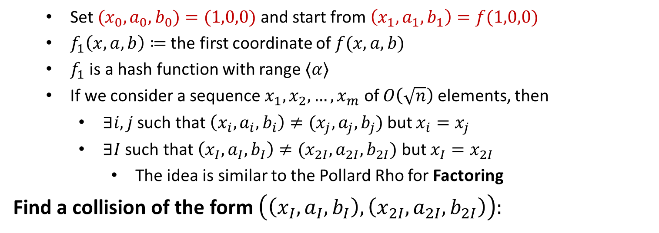
Pollard Rho Algorithm
Set $(x_{0},a_{0},b_{0})=(1,0,0)$ and start from $\left(x_{1},a_{1},b_{1}\right)=f(1,0,0)$
$f_{1}\left(x,a,b\right)≔$ the first coordinate of $f(x,a,b)$
$f_{1}$ is a hash function with range $〈α〉$
If we consider a sequence $x_{1},x_{2},…,x_{m}$ of $O\left(\sqrt{n}\right)$ elements, then
$∃i,j$ such that $\left(x_{i},a_{i},b_{i}\right)≠(x_{j},a_{j},b_{j})$ but $x_{i}=x_{j}$
$∃I$ such that $\left(x_{I},a_{I},b_{I}\right)≠(x_{2I},a_{2I},b_{2I})$ but $x_{I}=x_{2I}$
The idea is similar to the Pollard Rho for Factoring
Find a collision of the form $\left(\left(x_{I},a_{I},b_{I}\right), \left(x_{2I},a_{2I},b_{2I}\right)\right):$
$$(x_{1},a_{1},b_{1})$$ | $$(x_{2},a_{2},b_{2})$$ | $$(x_{3},a_{3},b_{3})$$ | $$⋯$$ | $$(x_{I},a_{I},b_{I})$$ | $$⋯$$
$$(x_{2},a_{2},b_{2})$$ | $$(x_{4},a_{4},b_{4})$$ | $$(x_{6},a_{6},b_{6})$$ | $$⋯$$ | $$(x_{2I},a_{2I},b_{2I})$$ | $$⋯$$

Slide 12
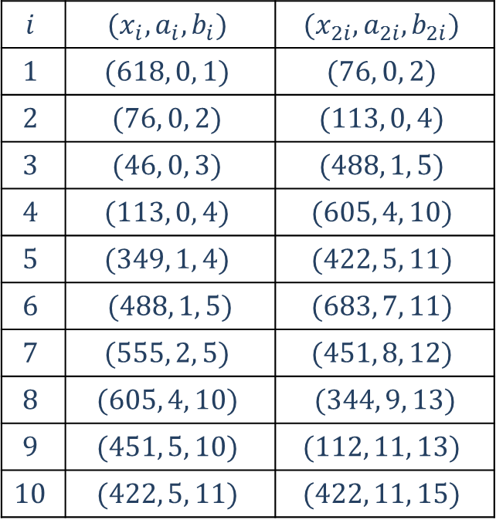

Pollard Rho Algorithm
EXAMPLE: $p=809, G=ℤ_{p}^{∗}, α=89∈G;\left|〈α〉\right|=101;β=618$
$n=101, β∈〈α〉=\left\{α^{0},α^{1},…, α^{100}\right\}$
$c:=\log_{α}{β}=?$
$c∈\{0,1,…,100\}$
$S_{1}=\{x∈ℤ_{809}^{∗}:x≡1 (mod 3)\}$
$S_{2}=\{x∈ℤ_{809}^{∗}:x≡0 (mod 3)\}$
$S_{3}=\{x∈ℤ_{809}^{∗}:x≡2 (mod 3)\}$
$G=S_{1}∪S_{2}∪S_{3}$
$\left(x_{10},a_{10},b_{10}\right)=(422,5,11)$
$\left(x_{20},a_{20},b_{20}\right)=\left(422,11,15\right)$
$x_{10}=x_{20}$
$c=\left(a_{20}−a_{10}\right){\left(b_{10}−b_{20}\right)}^{−1} mod n$
$=\left(11−5\right){\left(11−15\right)}^{−1} mod 101$
$=49$
$$i$$ | $$(x_{i},a_{i},b_{i})$$ | $$(x_{2i},a_{2i},b_{2i})$$
$$1$$ | $$(618, 0, 1)$$ | $$(76, 0, 2)$$
$$2$$ | $$(76, 0, 2)$$ | $$(113, 0, 4)$$
$$3$$ | $$(46, 0, 3)$$ | $$(488, 1, 5)$$
$$4$$ | $$(113, 0, 4)$$ | $$(605, 4, 10)$$
$$5$$ | $$(349, 1, 4)$$ | $$(422, 5, 11)$$
$$6$$ | $$(488, 1, 5)$$ | $$(683, 7, 11)$$
$$7$$ | $$(555, 2, 5)$$ | $$(451, 8, 12)$$
$$8$$ | $$(605, 4, 10)$$ | $$(344, 9, 13)$$
$$9$$ | $$(451, 5, 10)$$ | $$(112, 11, 13)$$
$$10$$ | $$(422, 5, 11)$$ | $$(422, 11, 15)$$

Slide 13


Pollard Rho Algorithm
ALGORITHM: Pollard-Rho$(G,n,α,β)$
procedure $f\left(x,a,b\right)$
if $x∈S_{1}$
then $f←(βx,a,\left(b+1\right)$ mod $n)$
else if $x∈S_{2}$
then $f←\left(x^{2},2a mod n,2b mod n\right)$
else $f←\left(ax,\left(a+1\right) mod n,b\right)$
return $\left(f\right)$
ANALYSIS:
$\gcd\left(b^{′}−b,n\right)=d>1$
Try all possible solutions
Complexity: $O\left(\sqrt{n}\right)$ iterations
main
define the partition $G=S_{1}∪S_{2}∪S_{3}$
$\left(x,a,b\right)←f\left(1,0,0\right)$
$\left(x′,a′,b′\right)←f\left(x,a,b\right)$
while $x≠x′$
do$\left\{\begin{aligned}\left(x,a,b\right)←f\left(x,a,b\right) \\ \left(x′,a′,b′\right)←f\left(x′,a′,b′\right) \\ \left(x′,a′,b′\right)←f\left(x′,a′,b′\right)\end{aligned}\right.$
if $gcd\left(b^{′}−b,n\right)≠1$
then return $(“$failure$")$
else return $\left(a−a^{′}\right){\left(b^{′}−b\right)}^{−1} \text{mod} n$

